Slide 1

Stay Upright campaign
Safety Session
Photo: Nina Mönkkönen / Finnish Road Safety Council

Slide 2
Content of the Safety Session
Background on commuting accidents
Where and how can you slip and fall on your way to work?
What measures do you have in place to prevent slips and falls during commutes?
Balance tips for the workday

Slide 3
Background on commuting accidents
There are more than 20,000 commuting accidents in Finland every year.
A significant proportion of commuting accidents occur to pedestrians. In 2024, 60% of commuting accidents occurred while walking, 23% while cycling and 12% while driving.
In 2024, there were over 14,000 commuting accidents involving pedestrians, 94% of which were caused by falling or slipping.
Weather conditions have a significant impact on commuting accidents. Most accidents occur when the temperature is around zero degrees Celsius and melting or freezing causes slippery conditions.
In 2024, the highest number of commuting accidents occurred in January and February.
On average, one in every hundred employees is injured while commuting each year.
Source: The Workers’ Compensation Center 2025

Slide 4
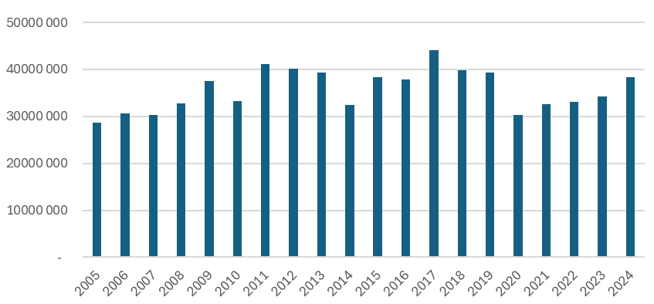
Compensation for pedestrian commuting accidents
Compensation for commuting accidents can be paid over several years. The graph shows the costs according to the year of payment, not the year of the accident.
The values in the graph have been adjusted to correspond to the year 2021 (2021=100).
The less slippery winters of 2014 and 2020 are also reflected in the compensation figures. In addition to this, the increase in remote working is particularly evident in the years 2021 and 2022.
Compensation adjusted by index (2021) by year of payment
Source: The Workers’ Compensation Center 2025

Slide 5
Injuries resulting from slipping and falling
Most often, injuries resulting from slipping and falling occur in the lower limbs (38%) or upper limbs (25%).
Typical injuries resulting from slipping and falling include bone fractures, sprains and bruises. Injuries caused by slipping and falling that require hospital treatment usually include various types of limb fractures and brain injuries.
In 2024, there were over 3,500 treatment courses in specialised healthcare due to slips and falls, and nearly 18,000 visits to specialised healthcare.
A wrist or ankle fracture caused by slipping and falling can also be an osteoporotic fracture related to age-related osteoporosis (especially in women over 50). In the event of a fracture, it is important to examine the possibility of osteoporosis.
Up to 60% of brain injuries are caused by falling. Around 100,000 Finns live with the after-effects of a brain injury. After-effects are defined as long-term or permanent symptoms caused by the injury, such as severe fatigue and memory problems.

Slide 6
Discuss:
Where and how can you slip and fall on your way to work?
Notes:
Where? Particularly high-risk situations include walking in your yard, getting in and out of a car or bus, walking or cycling to work and walking in the workplace parking lot.
Why? Reasons include rushing, being distracted by a phone, fatigue and slippery shoes.

Slide 7
Don’t let slippery conditions take you by surprise
Highly slippery conditions occur when:
snow falls on the ice
it rains on the ice or a layer of melted water forms on top of the ice
snow has been packed down and turned slippery after heavy snowfall, with temperatures around freezing or slightly below
slush has frozen and formed a slippery and uneven surface.
Check the pedestrian weather warning: https://en.ilmatieteenlaitos.fi/warnings
Employers can provide their employees with a slipping warning service: https://www.ilmatieteenlaitos.fi/liukkauspalvelu (page in Finnish)

Slide 8
Which of these measures will you adopt?
A reminder about staying upright on the intranet or in the break room ☐
Organising a prize draw to win anti-slip guards ☐
A feedback channel for accidents and close calls for all staff ☐
A bucket and shovel by the front door for gritting ☐
Pedestrian weather reports and warnings shared on the intranet or via messages ☐
An opportunity to test different types of anti-slip guards ☐
Participating in the Stay Upright campaign ☐
Informing staff of where to report deficiencies in the maintenance of the yard area (gritting, lighting, inadequate markings indicating level differences) ☐
A bench and rug at the entrance to make it easier to remove and clean anti-slip guards or other assistive devices ☐
Anything else? Please specify.

Slide 9
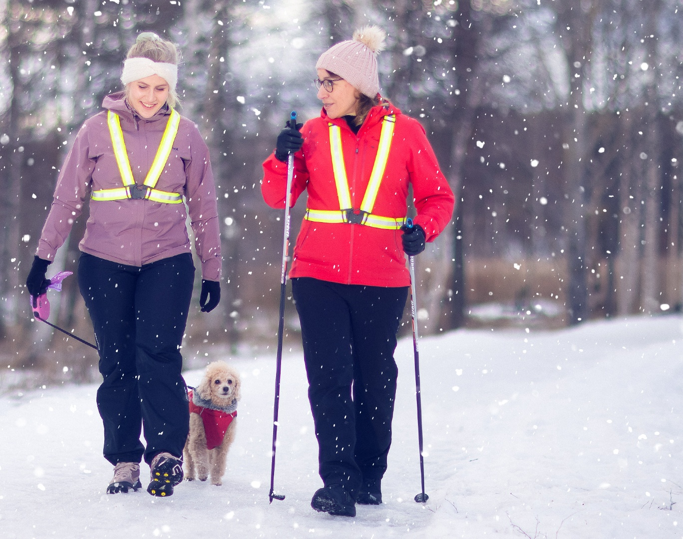
Seven ways to stay upright
– keep these in mind in your everyday life:
Focus on walking.
Keep your eyes forward and avoid using your phone while walking.
It will help you spot slippery spots in time.
Wear shoes that are suitable for the weather conditions.
Invest in winter shoes with good grip and a treaded sole.
Use anti-slip guards.
Get overshoe grips or studded shoes for very
slippery conditions.
Stay in shape and keep alert.
Good balance, muscle strength and concentration can help you react to unexpected situations and prevent fractures.
Check the pedestrian weather warning.
Check the weather forecast and the Finnish Meteorological Institute’s
pedestrian weather warning before going out.
Make time for commuting.
Avoid rushing and anticipate the time needed to move in the winter weather.
Give feedback to maintenance.
Notify the municipality or property maintenance of unploughed or
ungritted walkways.
Photo: Mikko Vähäniitty / Finnish Red Cross

Slide 10
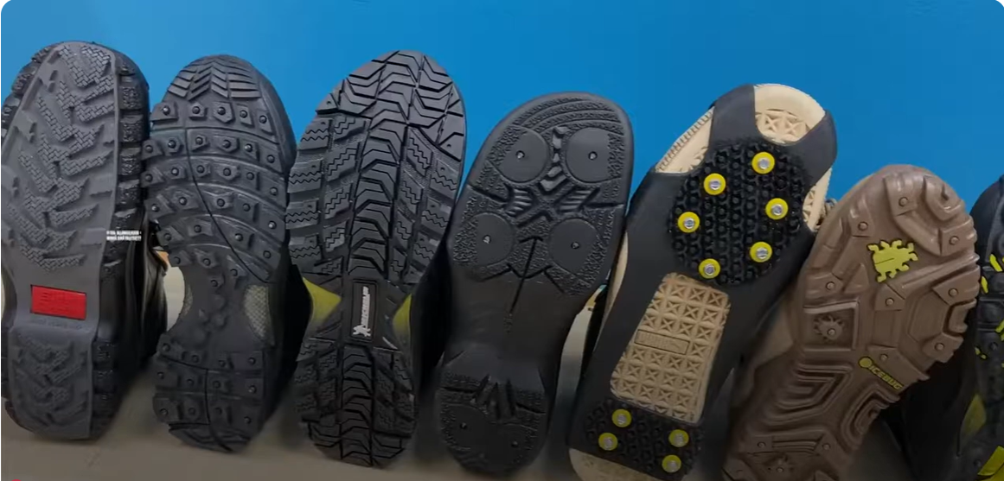
Grip for walking – which one do you choose?
Watch the video on YouTube
https://www.youtube.com/watch?si=pKWTIpdJNAWwBcyV&v=PzpdlSF_onM&feature=youtu.be
Notes:
Pitoa jalankulkuun – minkä sinä valitset? – YouTube

Slide 11
Balance exercises – do one or all
1. Figure eight
  Stand up with your back straight and your eyes forward.
  Lift one leg in the air in front of you and move it in the air in a figure eight motion.
  Repeat the movement a total of five times with the lifted leg.
  Then switch legs and do the movement with the other leg five times.
2. Heel raises
  Stand up with your back straight and your eyes forward.
  Calmly lower yourself into a squat position, rise from squatting to standing and then raise your heels.
  Lastly, raise both arms straight up and reach towards the ceiling, standing with heels raised.
  Return to standing position with arms at your sides. Repeat the movement ten times.
3. Tandem walk
  Stand up with your back straight and your eyes forward.
  Step backwards with one foot so that your toes touch the heel of the other foot – imagine walking backwards along a straight line.
  Take 10 steps like this, turn around and walk back 10 steps in the same way.
  If you feel like adding more challenge to the movement, you can rotate your head from side to side with each step.
Notes:
: https://luustoliitto.fi/wp-content/uploads/d-taso-2021-web.pdf

Slide 12
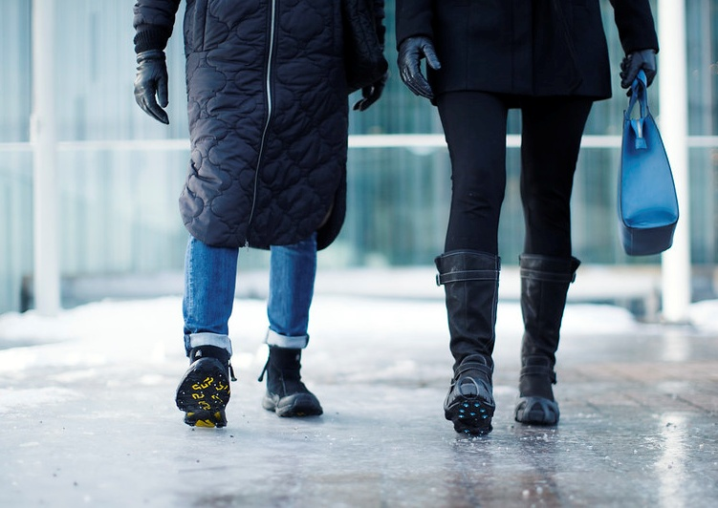
Thank you – let’s stay upright.
Sources: THL. 2024. Hoitoilmoitusrekisteri (Care Register for Health Care).
The Workers’ Compensation Center. 2025. Työmatkatapaturmissa liikkumisvalinnoilla on väliä (Mobility choices matter in commuting accidents).
Publications of the Ministry of Transport and Communications 2/2022
Photo: Nina Mönkkönen / Finnish Road Safety Council

